Slide 1
MOVIE API
MODELING
by TITO VASQUEZ

Slide 2

Description
This project is about the development of an ApiRest, which will allow the user to see a list of movies which can, comment, rate, filter through a given year, etc.

Slide 3

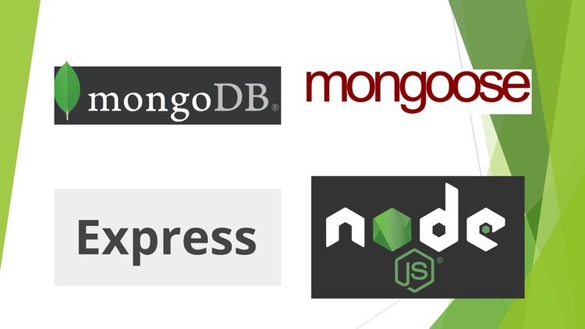
Api Architecture
It is composed of three of the most important technologies in the industry, Each of these technologies provides functionality within the Stack:
MongoDB: It is the NoSQ database that will allow us to store information.
Node.js: It allows you to run Javascript from the server side. - Application server.
Express.js: It is the server's Web JavaScript framework
Mongoose: It is a JavaScript library that allows you to define schemas with strongly typed data.

Slide 4
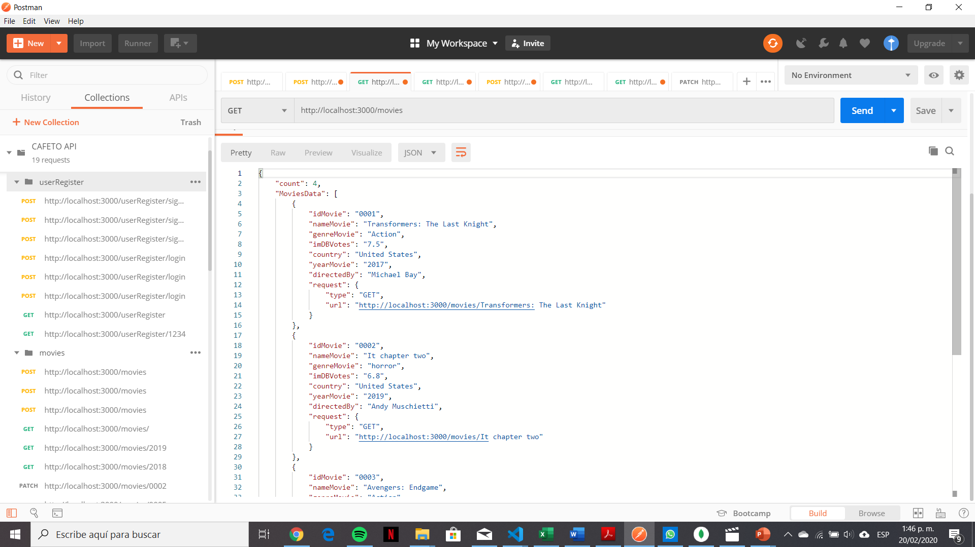
Json record in Postman
It receives the data on the server and is stored in the database.

Slide 5
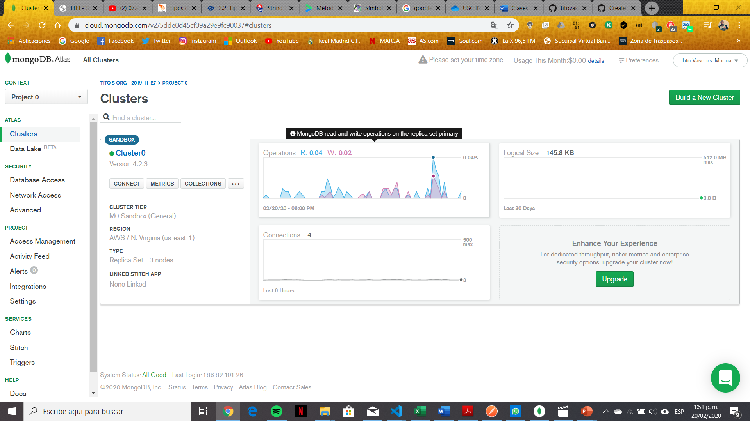
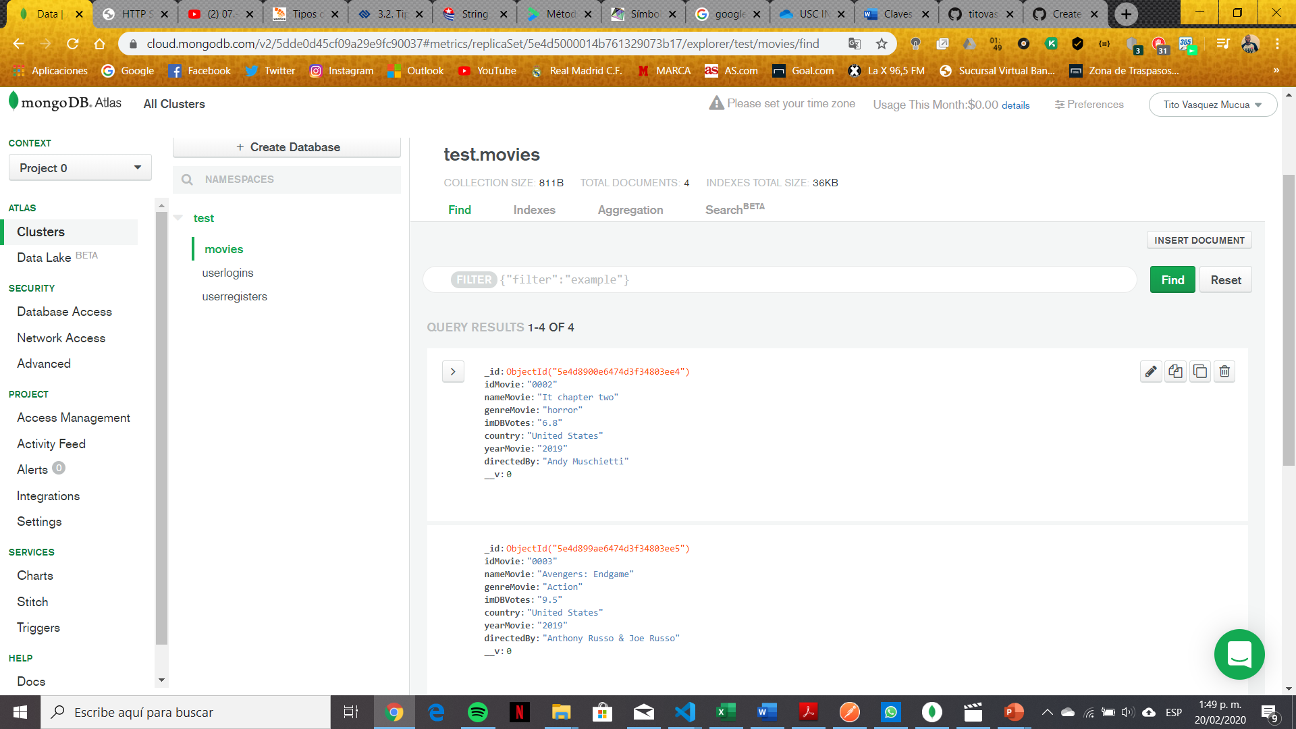
Records Stored in the Database
Test data is recorded on the server and stored in the MongoDB database.

Slide 6
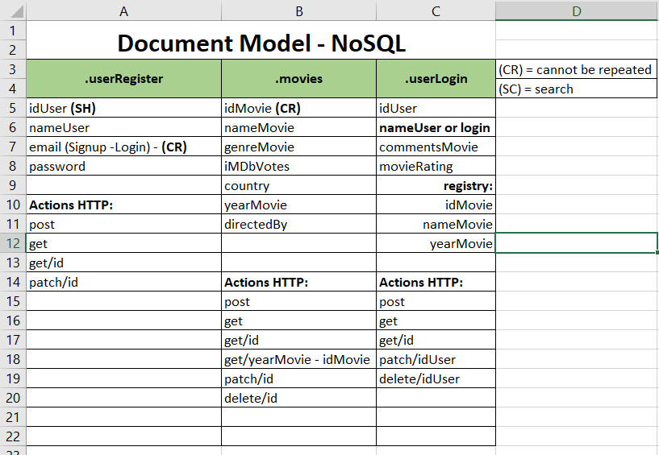
Document Model - NoSQL

